Slide 1


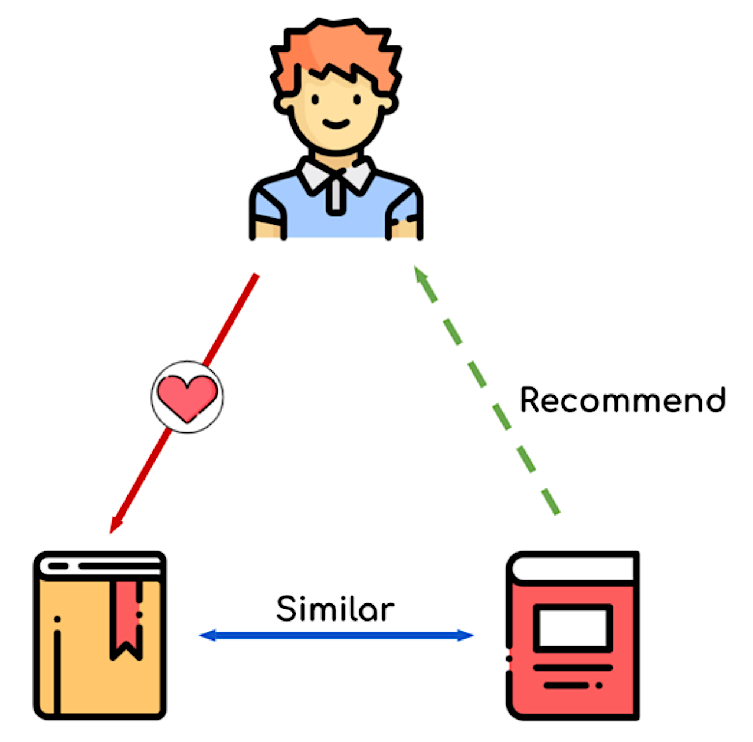
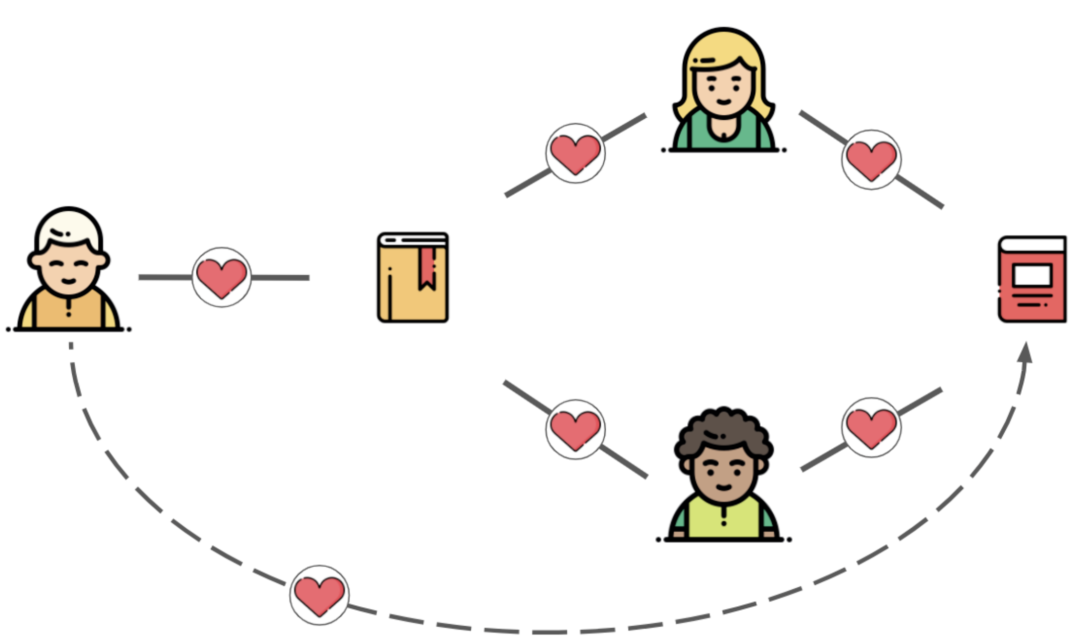
Movie Recommender
Web Application Design
Enter User Id
New users
with little or no historical rating data
Existing users with sufficient historical rating data
Text Search
Ranked-Based (Cold start)
Content-Based
Collaborative filtering
New user: no or < 20 reviews
Search text entered by user
Example: ‘batman’, ‘animal-based superhero’
User have at least 20 reviews
1
2
3
4
5
6
7
9
10
Input search text
Top ranked movies
Using highest number of reviews in IMDB
Suggestions contains similar text as input text provided by the user
Find users with the most similar preferences and suggest their movies the user did not yet watched.

Slide 2
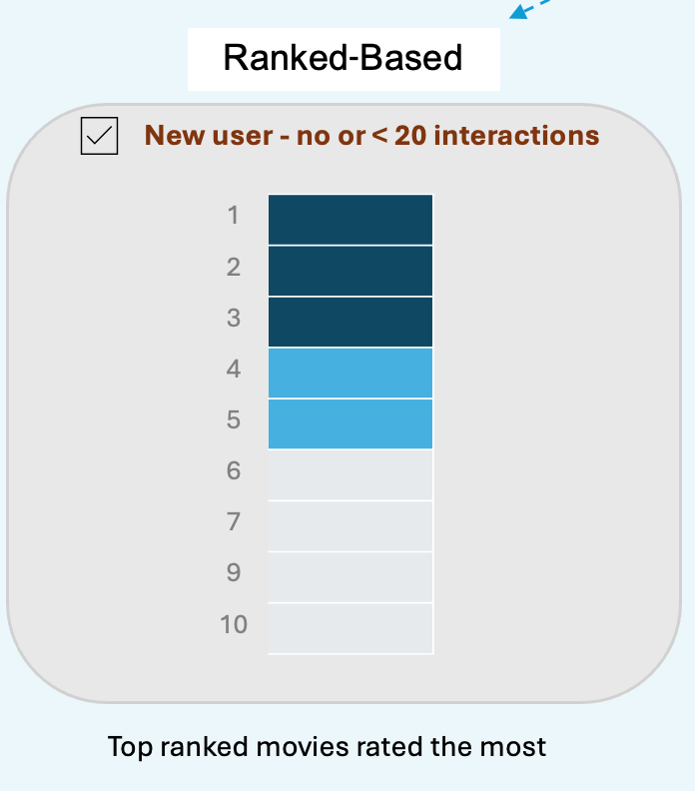

Slide 3
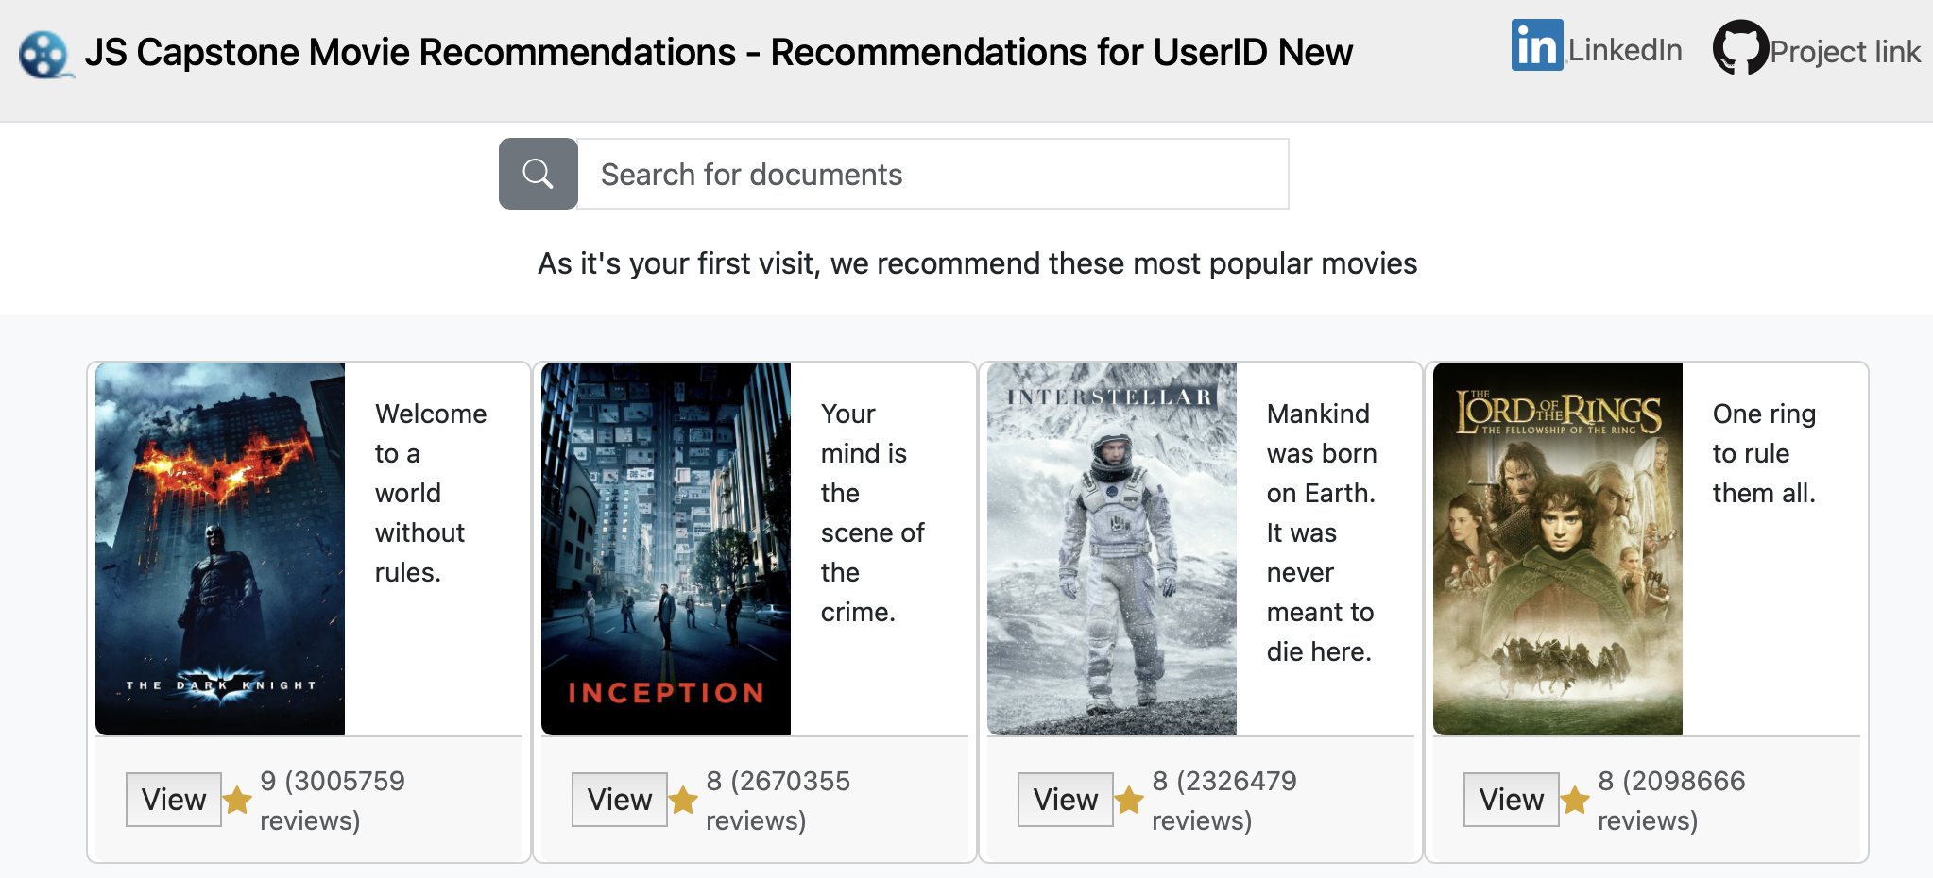
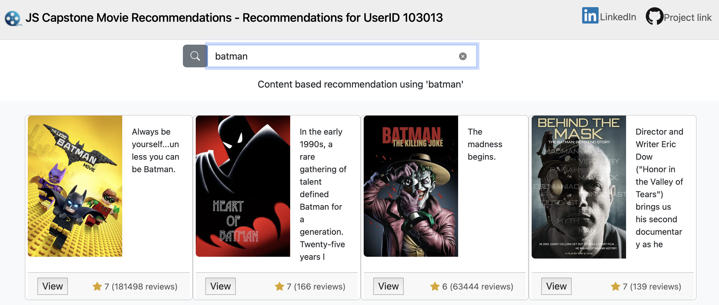
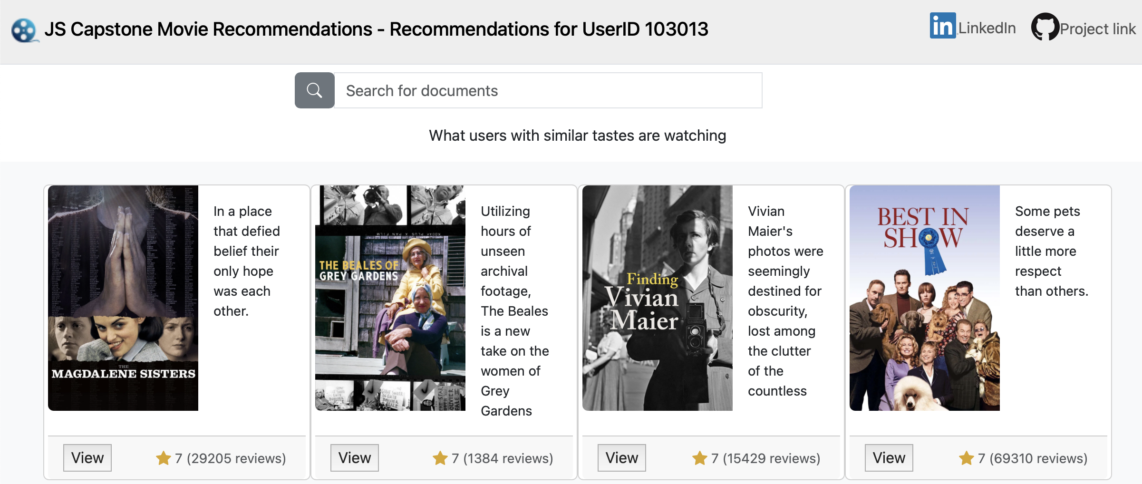

Slide 4
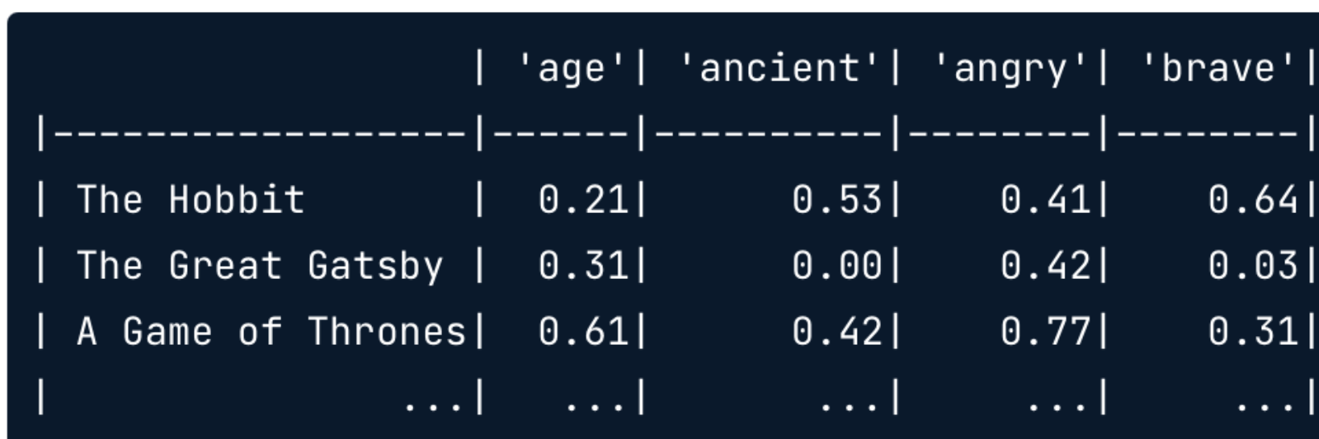
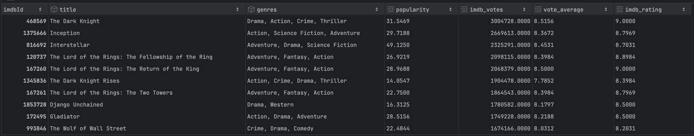

Slide 5
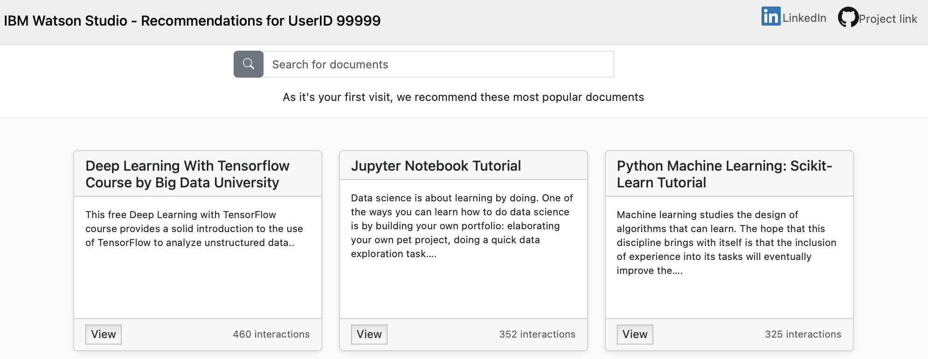

Slide 6
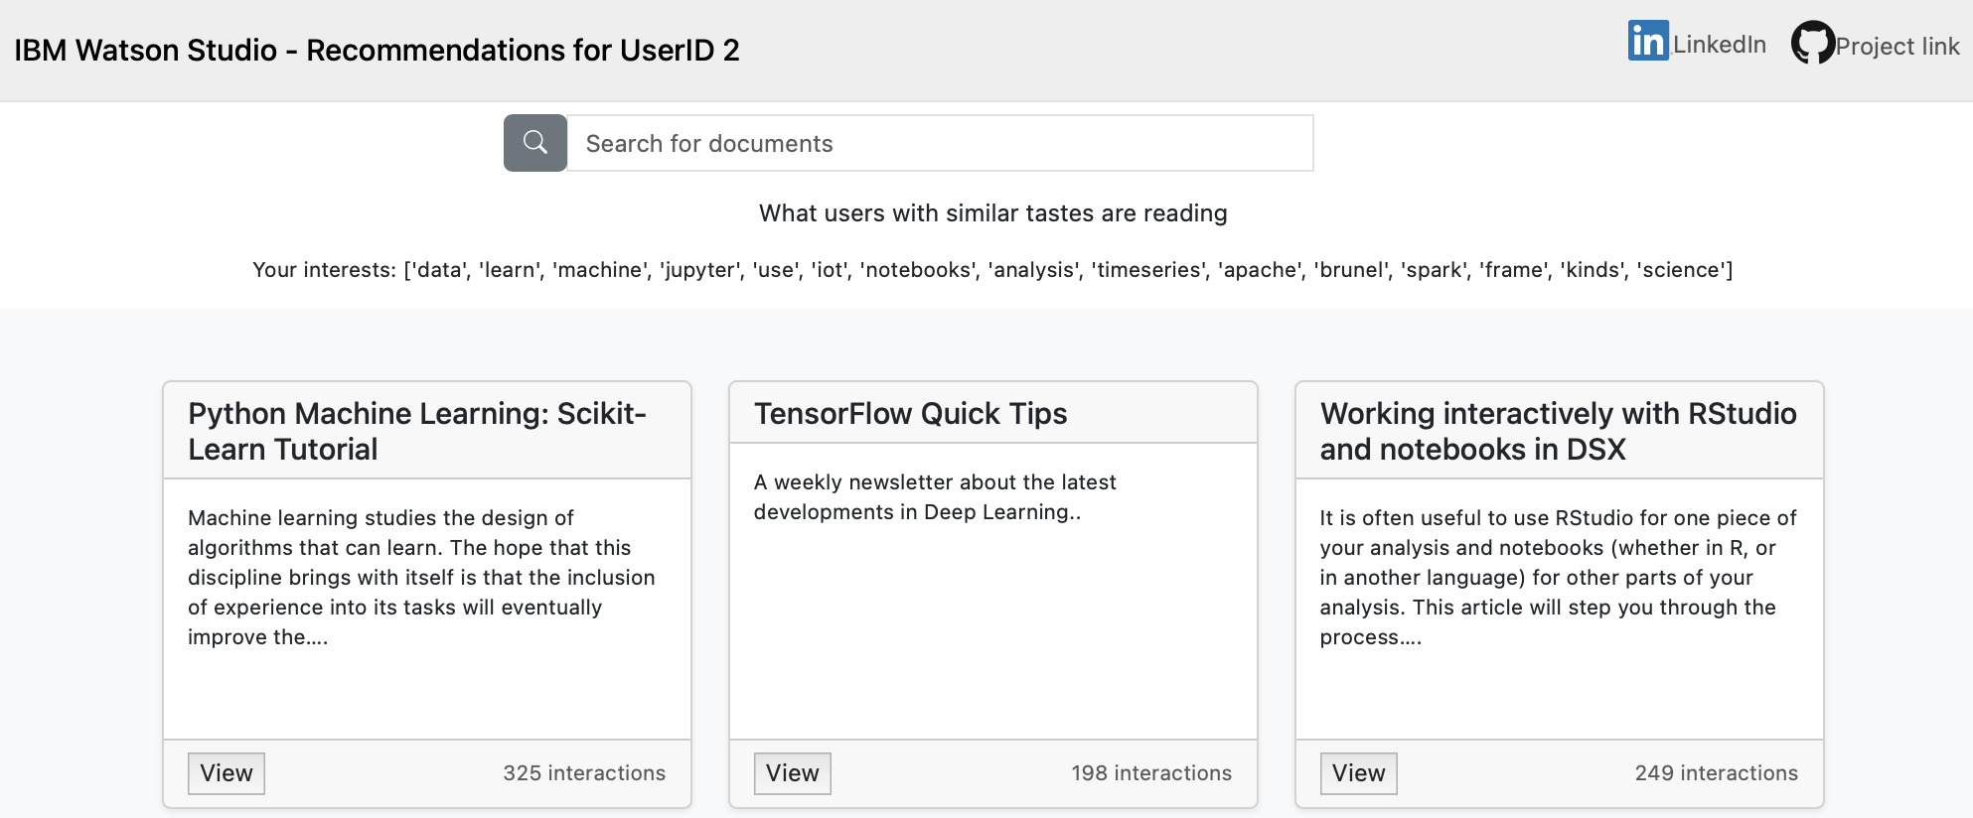

Slide 7
